Slide 1
Bat vs Rat: The Forage Files
HIT140 Assessment 2 – Group Project
Ashish Shrestha
Sudip Lamichhane
Suraj Raut
Anurag Regmi
Notes:
Introduction to the project. We are investigating whether Egyptian fruit bats perceive black rats as predators or competitors.

Slide 2

Agenda
Background of study and research question
Data sources and cleaning methodology
Descriptive statistics and visual analysis
Inferential statistical testing
Interpretation of findings
Conclusions, limitations and future work
Reproducibility and submission requirements
Notes:
This agenda outlines the flow of our presentation.

Slide 3

Background & Research Question

Slide 4
Study Background
Egyptian Fruit Bats (Rousettus aegyptiacus) share food resources with Black Rats (Rattus rattus).
Over 7 months, zoologists observed interactions at a provisioned food platform.
Video footage was manually coded to record bat landings, behaviours, rat arrivals, and food availability.
The aim was to test if bats alter behaviour due to rats acting as competitors or as perceived predators.

Slide 5

Research Question
Do bats perceive rats only as competitors, or also as potential predators?
Hypothesis: If perceived as predators, bats will show more avoidance and vigilance.
Operationalised using the risk variable: 0 = avoidance, 1 = risk-taking.
Other contextual variables include timing (seconds after rat arrival, hours after sunset) and season.
Notes:
This defines the research problem clearly.

Slide 6
Data & Cleaning
Notes:
We now introduce the datasets and cleaning steps.

Slide 7
Dataset Overview
Dataset1 (907 rows): Each bat landing event with variables such as risk, reward, seconds after rat arrival, hours after sunset, and season.
Dataset2 (2123 rows): Each 30-minute observation interval with rat arrivals, rat minutes, bat landings, food availability, and time after sunset.
Together these datasets link individual bat behaviours with environmental and seasonal context.
Notes:
These datasets are complementary: Dataset1 is individual-focused, Dataset2 is environment-focused.

Slide 8

Data Cleaning Steps
Datetime fields parsed (landing time, rat period times, sunset, observation time).
Numeric conversion of behavioural and contextual variables.
Missing values in 'habit' filled with 'unknown'.
Derived seasons from months, mapped to Northern Territory seasonal cycle.
Created categorical bins for seconds since rat arrival to examine patterns over time.
Notes:
These steps ensured consistent data structure for analysis.
.

Slide 9

Descriptive Analysis
Notes:
Now we examine descriptive statistics and plots.

Slide 10
Descriptive Statistics
Dataset 1: 907 bat landing events
- Risk-taking: 49.5%, Avoidance: 50.5%
- Rewards: 53.4% rewarded vs 46.6% no reward
Dataset 2: 2123 rat period summaries
- Variables: rat minutes, arrivals, food availability
- No missing values

Slide 11
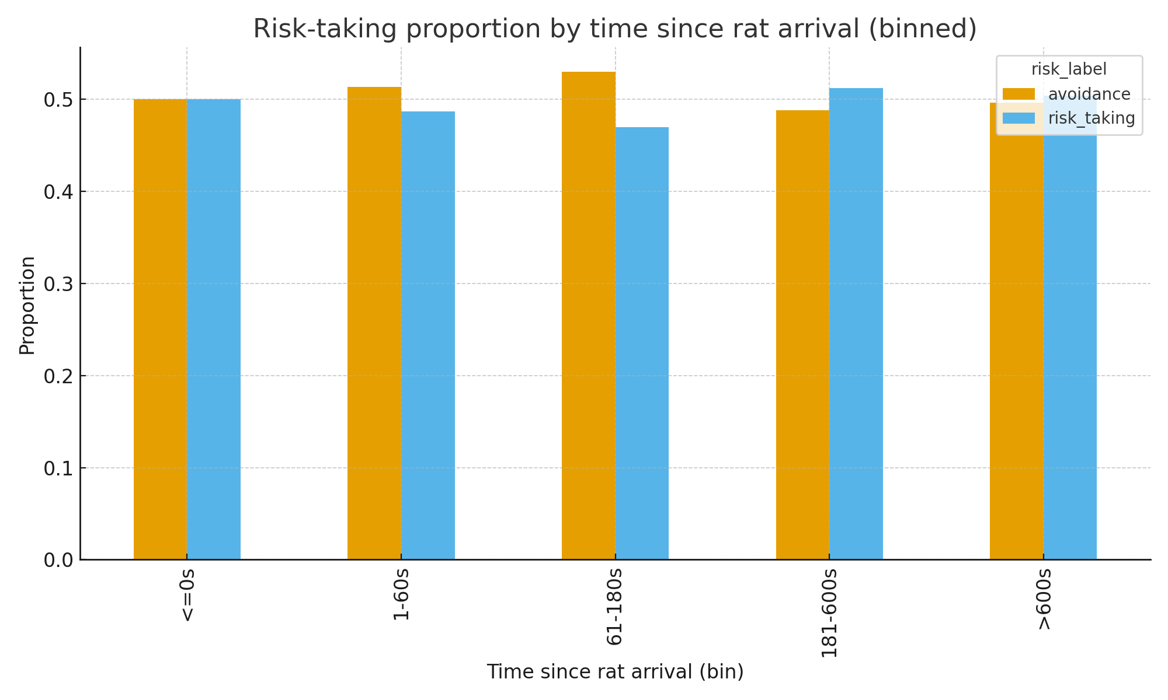
Risk vs Time Since Rat Arrival
Bar chart of risk-taking proportions across bins of time since rat arrival.
Risk-taking is lowest immediately after rats arrive (0–60s).
Proportion of risk-taking increases as more time passes after rat arrival.
This recommends bats are cautious when rats are newly present, consistent with predator perception.
Notes:
This plot shows avoidance right after rats appear.

Slide 12
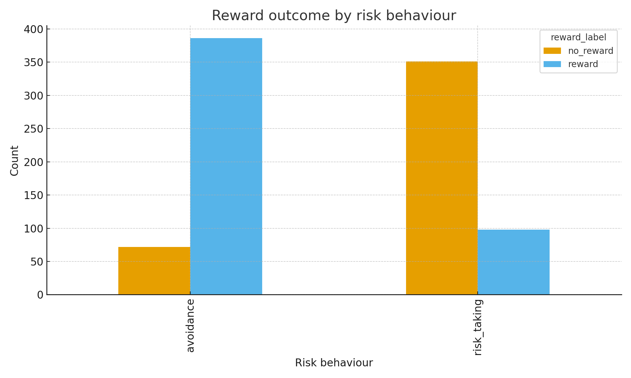
Reward vs Risk Behaviour
Risk-taking often leads to food rewards, but with some failures.
Avoidance results in fewer rewards, showing trade-off between safety and food.
This illustrates the cost-benefit dynamic influencing bat choices.

Slide 13
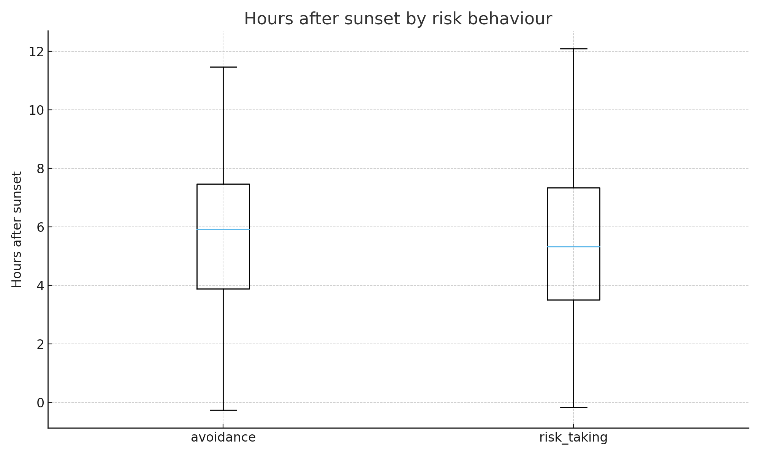
Hours After Sunset & Risk Behaviour
Risk-taking more common at specific times of night, indicating behavioural rhythm.
Avoidance tends to occur earlier in the night compared to risk-taking.
Timing suggests interplay between light levels, hunger, and rat presence.

Slide 14
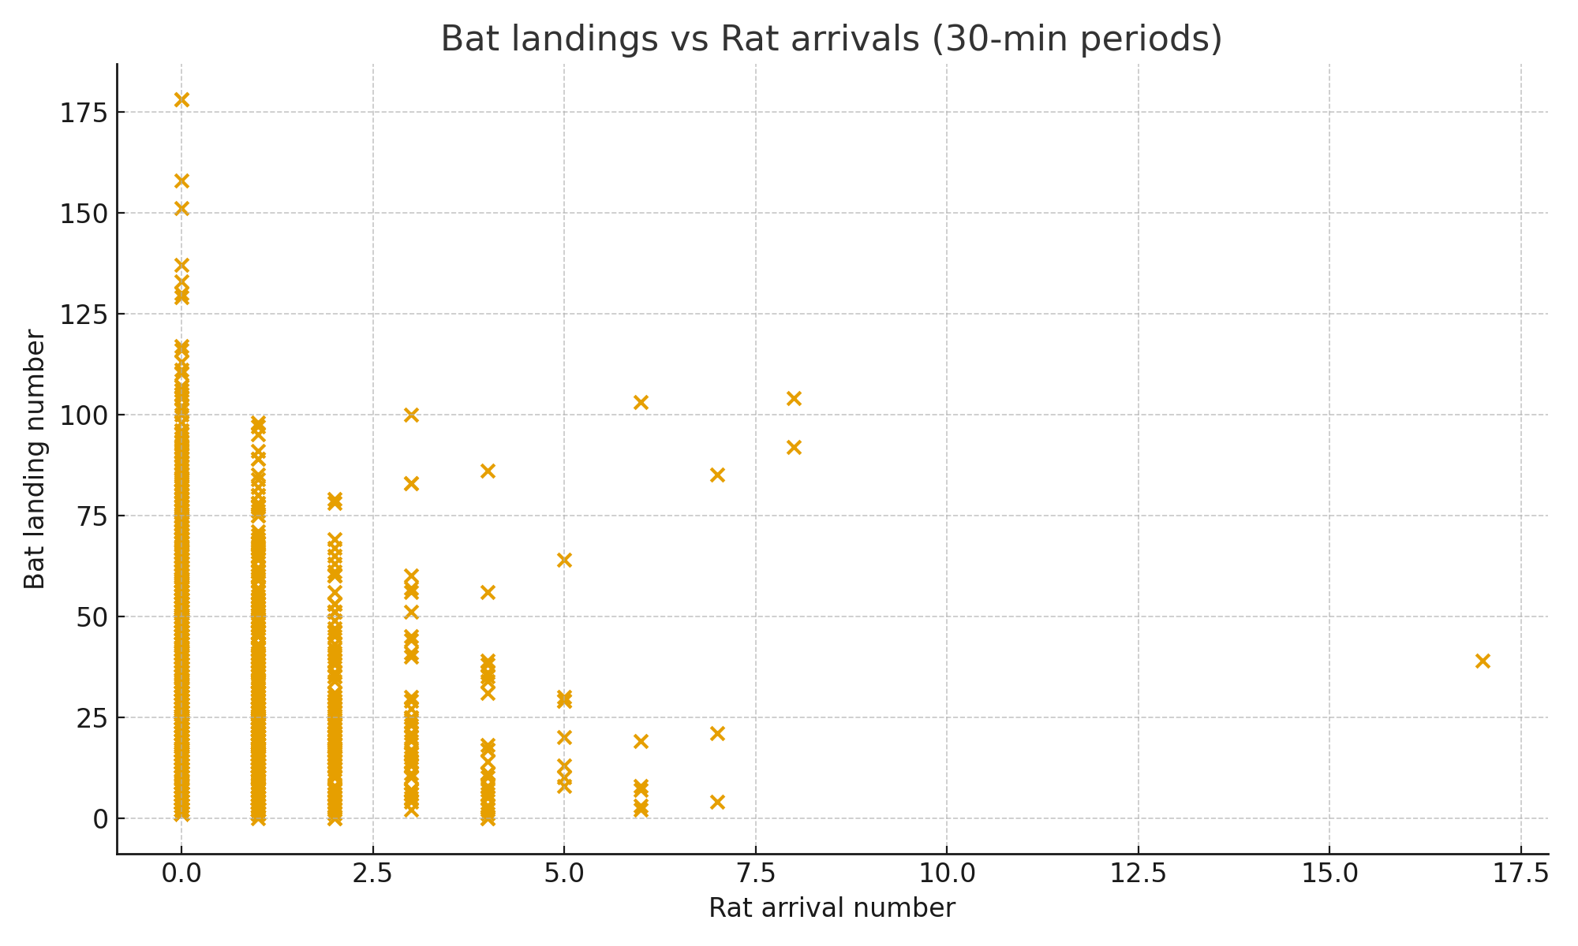
Bat vs Rat Arrivals (Dataset2)
Scatterplot of bat landings vs rat arrivals per 30 minutes.
Higher rat arrivals sometimes coincide with fewer bat landings, indicating competition.
However, bats still land even with many rats present, showing mixed strategies.
This plot illustrates environmental pressure from rat presence.
Notes:
This chart gives ecological context.

Slide 15
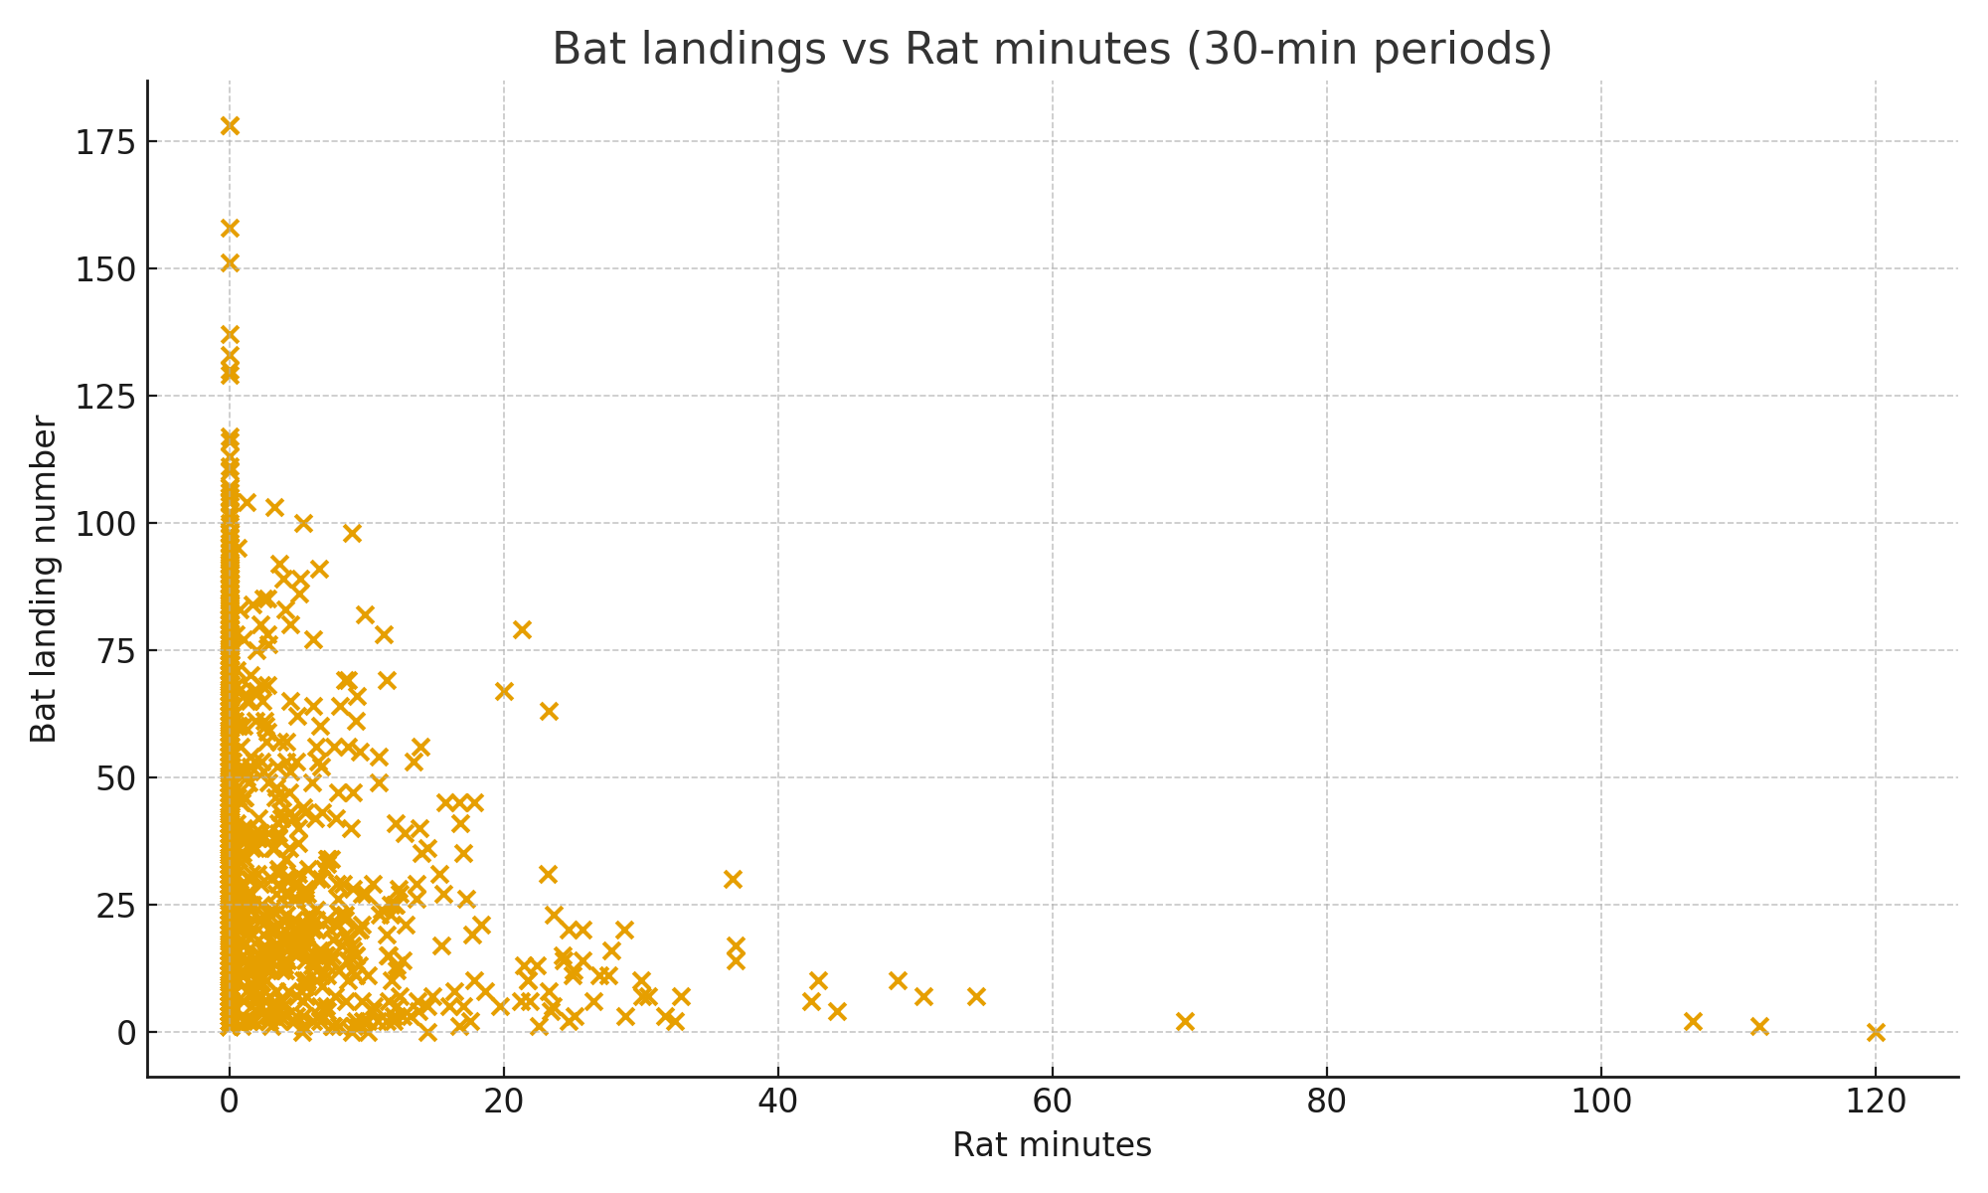
Bat vs Rat Minutes Present (Dataset2)
Scatterplot of bat landings vs rat minutes per 30 minutes.
Longer rat presence often correlates with fewer bat landings.
This indicates rats discourage bat activity through persistent competition.
Further analysis needed to confirm if bats adjust behaviour strategically.

Slide 16
Inferential Analysis
Chi-square (Risk vs Reward): Significant (p<0.001)
Chi-square (Risk vs Season): Not significant (p=0.082)
Logistic Regression:
- Season effect significant (p=0.049)
- Hours after sunset borderline (p=0.060)
- Rat arrival not significant
OLS Regression:
- Food availability increases landings
Rat minutes reduce landings
This model confirms rats influence overall bat foraging intensity.

Slide 17
Chi-square Tests
Risk vs Reward: Significant association found; risk-taking influences reward outcomes.
Risk vs Season: Behaviour varies by season; more avoidance in resource-scarce seasons.
Both results support the idea that bats balance food acquisition with risk from rats.
Notes:
Chi-square tests show dependence between risk, rewards, and season.

Slide 18
Logistic Regression
Model: risk ~ seconds_after_rat_arrival + hours_after_sunset + season.
Recent rat arrival reduces odds of risk-taking, increasing avoidance.
Hours after sunset influences risk, with higher risk-taking later in the night.
Seasonal effects also evident, showing environmental modulation of behaviour.
Notes:
Regression quantifies how predictors shape risk behaviour.

Slide 19

Interpretation & Conclusion
Descriptive and inferential results converge bats avoid risk immediately after rat arrival.
Risk-taking yields food rewards but with increased risk of conflict.
Seasonal variation indicates flexibility in behaviour depending on food availability.
Overall, bats treat rats as both competitors and potential predators.

